Slide 1
Session 3 – Automation & Testing Data Skills for Research Kellogg Research Support
August 15, 2023
Notes:
Welcome. We are so happy you’re here.
What you are about to hear next is about the closest you will get to a lecture in this workshop series. Most of the rest of this will be pretty interactive.
There will be discussions and you follow along with a demonstration, and maybe try to solve a few problems yourself.
But before we get into demonstrations of tools and how to apply them to your research work, I want to talk a bit about the reproducibility of that work you are about to start.
It is a very important topic, and I believe there are a few general principles that, if kept in mind, can help you quite a lot when you go to reproduce your work in the future.

Slide 2
Automation
Declarative > Procedural
Modular > Monolithic
Automatic > Manual
Notes:
All these things turn procedural unspoken knowledge into explicit, declarative and executable specifications

Slide 3
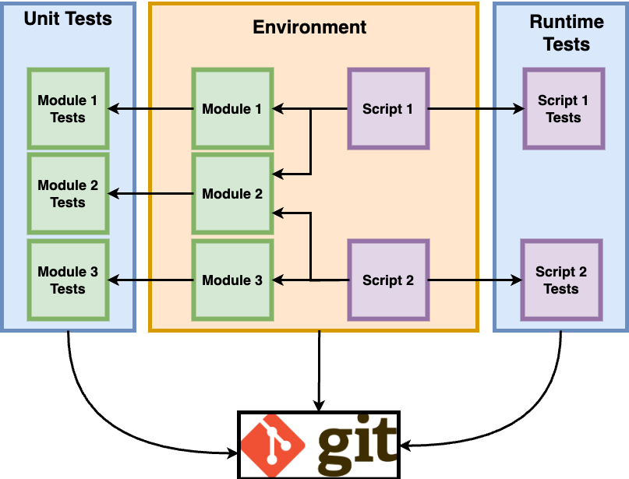
Big Picture
Version Control

Slide 4
Any Program Is An Example of Automation
Notes:
JOHN
Any program leaves a self-documenting record of what steps you run (if you run the program.)
Discussion point: How might you tell if your program leaves a good record or a poor one?

Slide 5
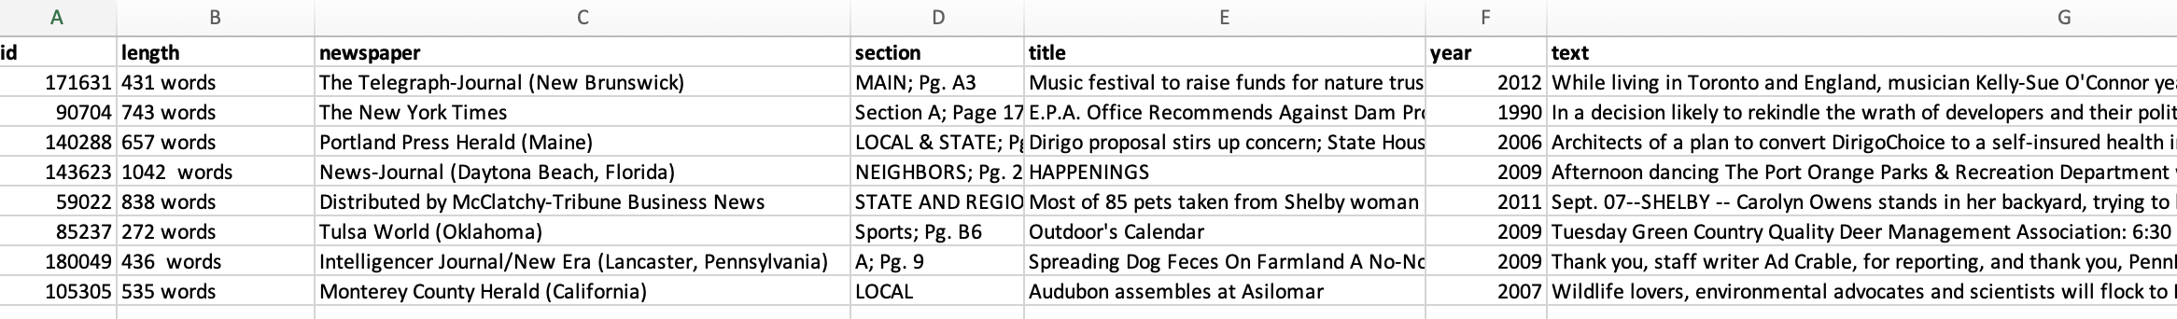
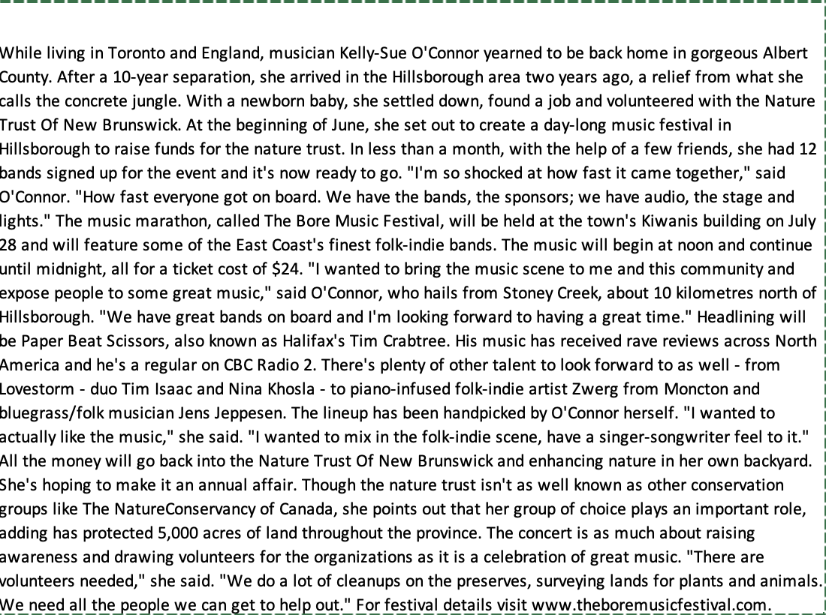
Example: Using OpenAI
Structured Data

Slide 6
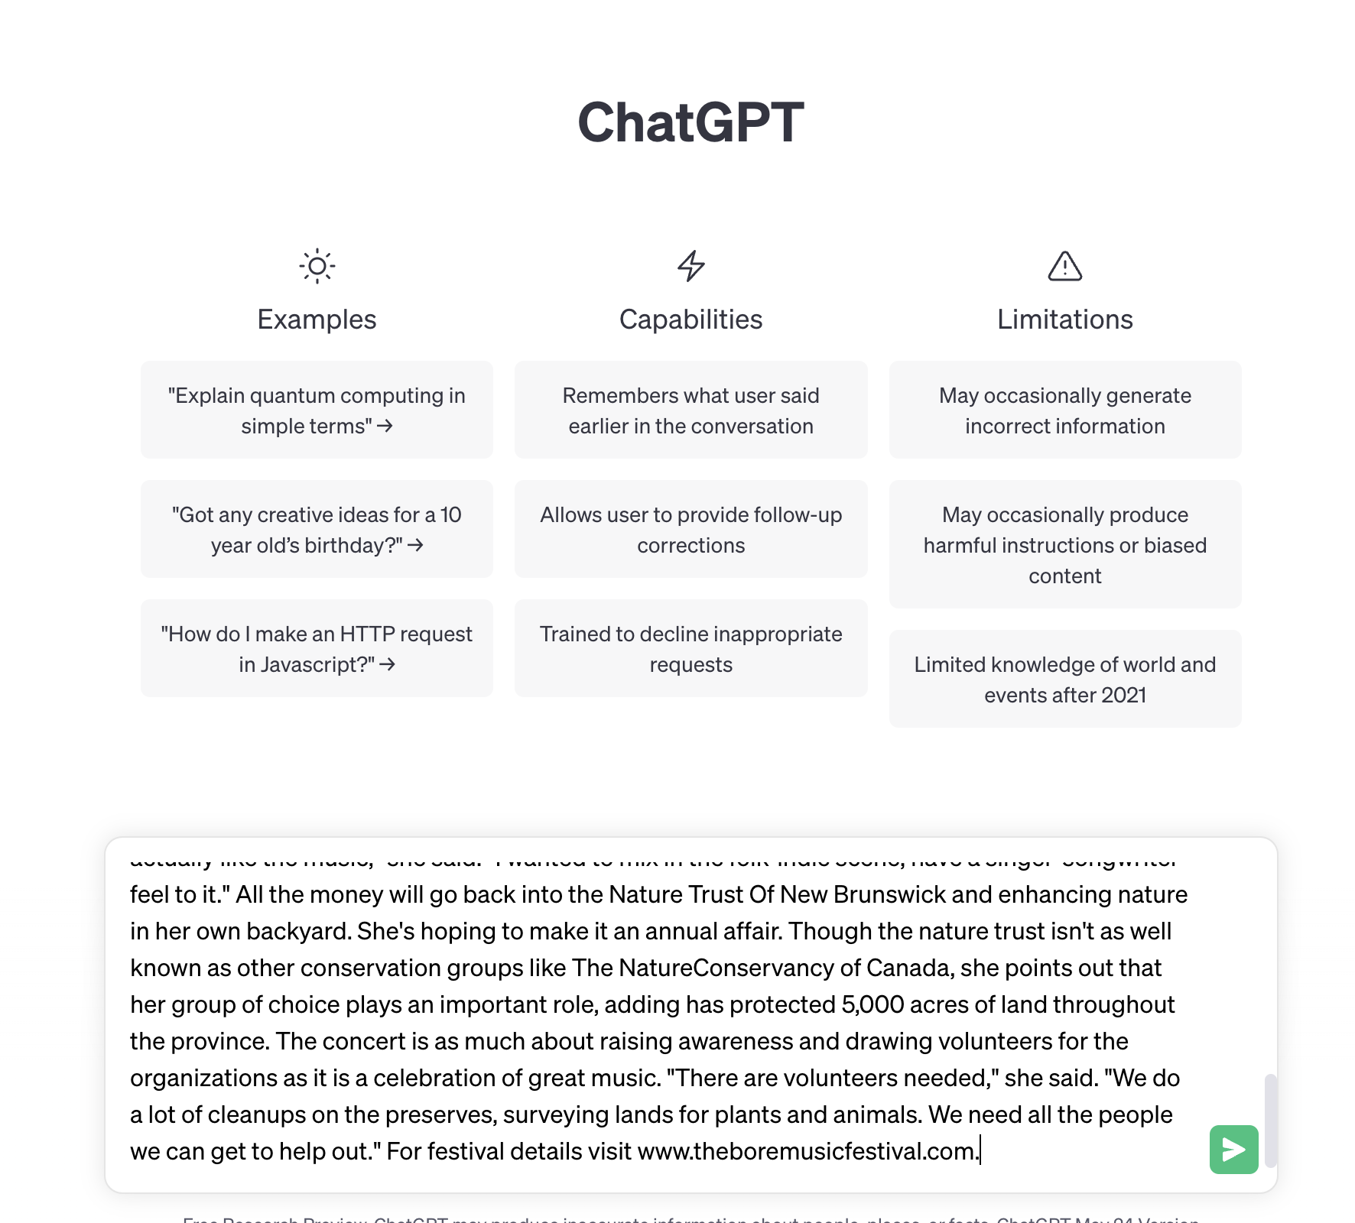
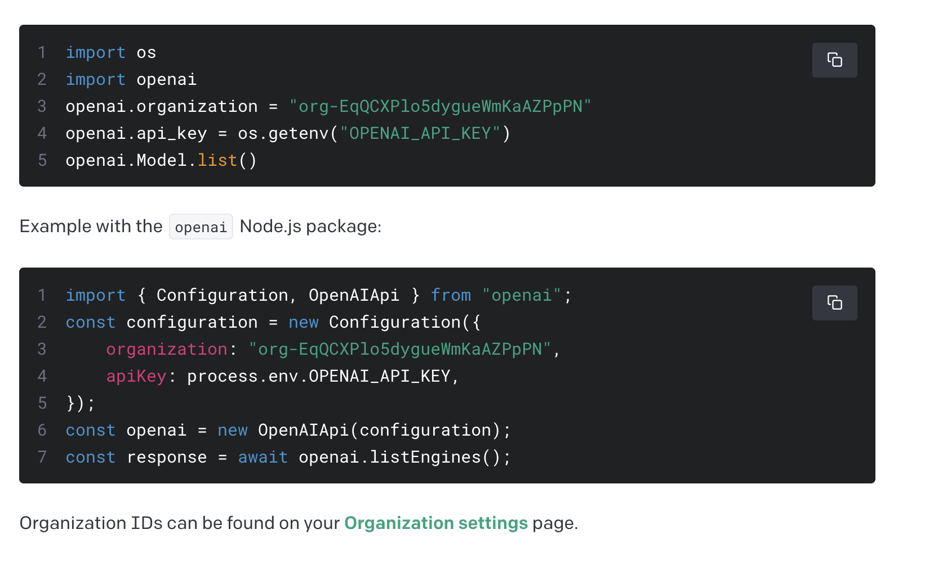

Example: Using OpenAi
Point and click vs. code
Notes:
Otrher examples: 10K collection, WRDS API

Slide 7
Programs Can Script Complex Workflows
raw data
raw data
model-ready data
results
transformations
analysis
raw data
raw data
update inclusion,
model specs
obtain more data
Notes:
JOHN
Your research project will go through many steps from its start to its final output.
Yesterday we urged you to break your steps down into discrete pieces so that you have a clean record of each step.
Scripting the overall pipeline is important for documenting which pieces were run and when.

Slide 8
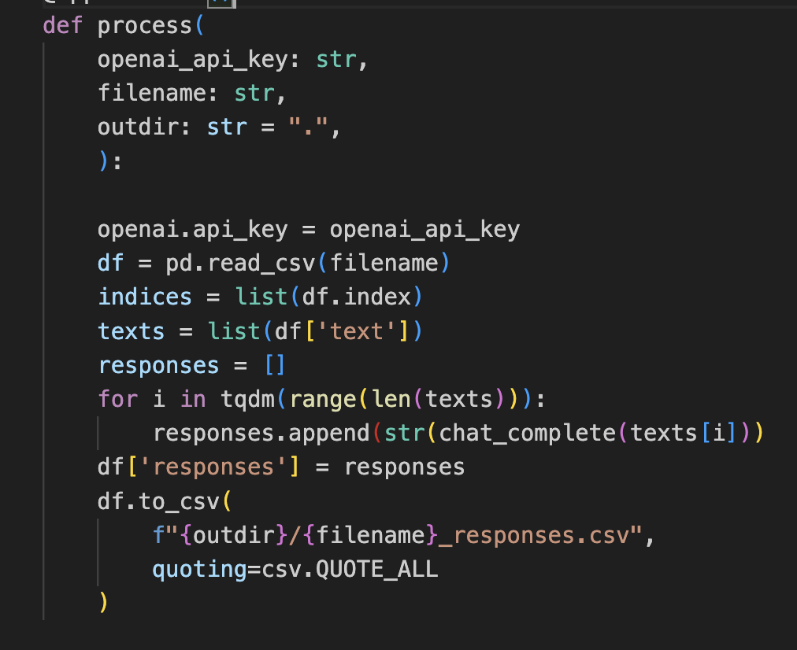




Programs Can Script Complex Workflows
Read data
Process data
Save output
Notes:
JOHN
Your research project will go through many steps from its start to its final output.
Yesterday we urged you to break your steps down into discrete pieces so that you have a clean record of each step.
Scripting the overall pipeline is important for documenting which pieces were run and when.

Slide 9
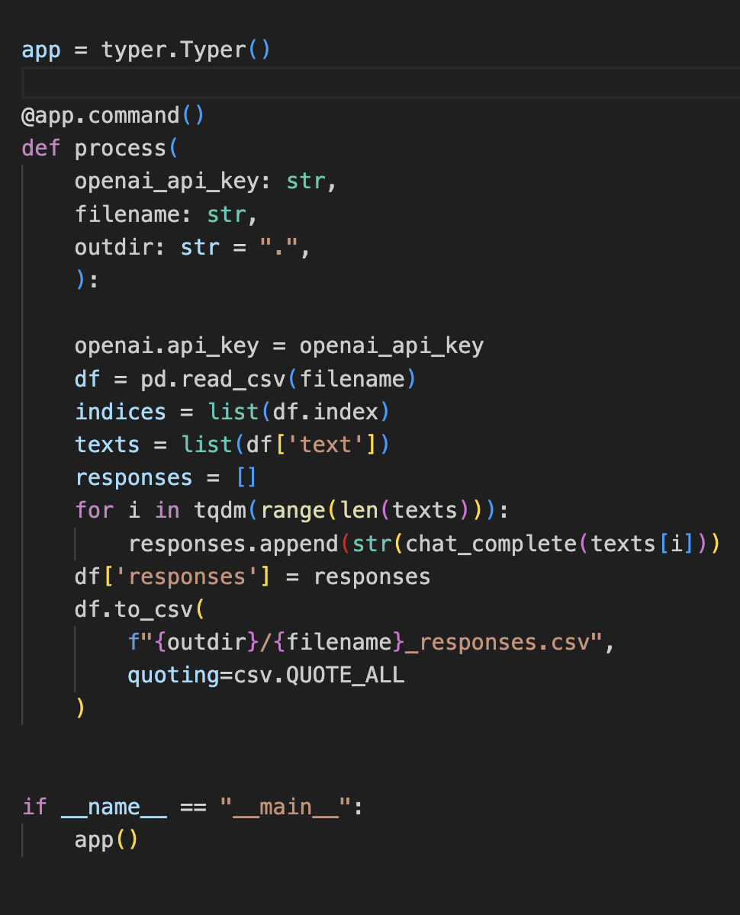
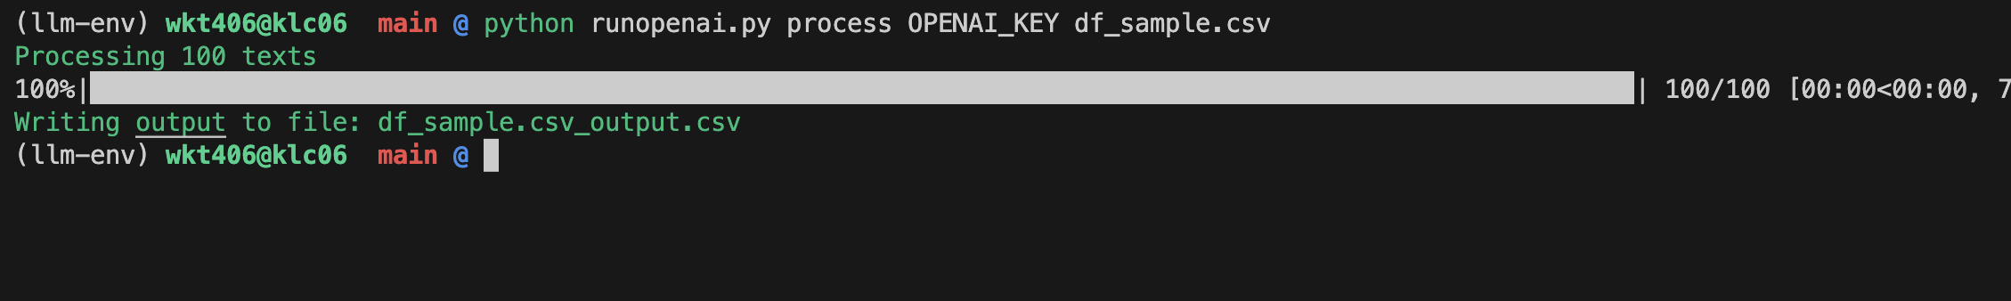
Technique: Batch processing a program
Turn function into a CLI
Execute CLI in the terminal
Notes:
You saw this during the KLC intro yesterday, and it bears repeating; all future sessions will show examples of batch processing.
Explain background processes and what happens when you launch a process and log out (or get logged out)
Probably want to do a quick demo of screen

Slide 10
Next Level: Run Programs in Sequence
Run OpenAI CLI
Parse output into JSON
Update Database
Notes:
The next level: Write a script that will run a sequence of steps one after the other
Maybe show executable file with single commands as simplest version of this?
Discussion: What are some things that could go wrong if you just run 1, 2, 3, 4, 5 in a row?

Slide 11
Test Input Conditions Before Running
Ensure OpenAI API connection
Ensure number of text tokens is under context limit
Does required input file exist?
Does it contain the elements you assume are there?
Notes:
Needs notes

Slide 12
Controlling The Execution Of Your Script
Executing steps in a pipeline, test output
Passing in arguments
Notes:
Show examples of how to control execution of a script.
Maybe one flavor where you use bash, and another where you use a Python wrapper to control it?

Slide 13
Test Output Results During Run Time
Test output of OpenAI is valid
Try/catch blocks (various exceptions are possible)
Was output file created? (e.g. quota issue)
Notes:
File size, processing time expected?
Multiple tests (even "redundant" ones) usually help

Slide 14
Logging Output Results During Run Time
Log output to output file – if the program crashes we don't want to lose work (costs time and money)
Log errors and exceptions when they occur
For long running processes (like cron jobs), send some kind of alert
Notes:
Print statements, printing to file.
Discussion: What should you print to file? In what format?

Slide 15
What To Do When Run Time Tests Fail?
Keep going, just log results
Stop program execution
Pause and retry
Examine error code and decide what to do
Notes:
Introduce "exception handling" as a term.
Consider 3 different scenarios where you have to decide whether to...
Continue with the rest of the steps, then go back and rerun just the ones that failed?
Wait and then restart where the job failed
Abort the process, and fix your code before starting again

Slide 16
Finishing Steps
Notes:
Make these things habits
Run your unit tests, examine changes
Generate your output (whatever it might be)
Commit important changes to GitHub
Update conda environment if needed

Slide 17
How To Update Conda
Notes:
Needs notes

Slide 18
Takeaways
Automate everything
Test liberally (development and runtime)
Log incremental output on long running jobs
Commit changes frequently (coherent state)

Slide 19
Further Independent Reading
Notes:
How crontabs work
Syntax for bash scripts
Containerizing other things besides package environment?

